Slide 1
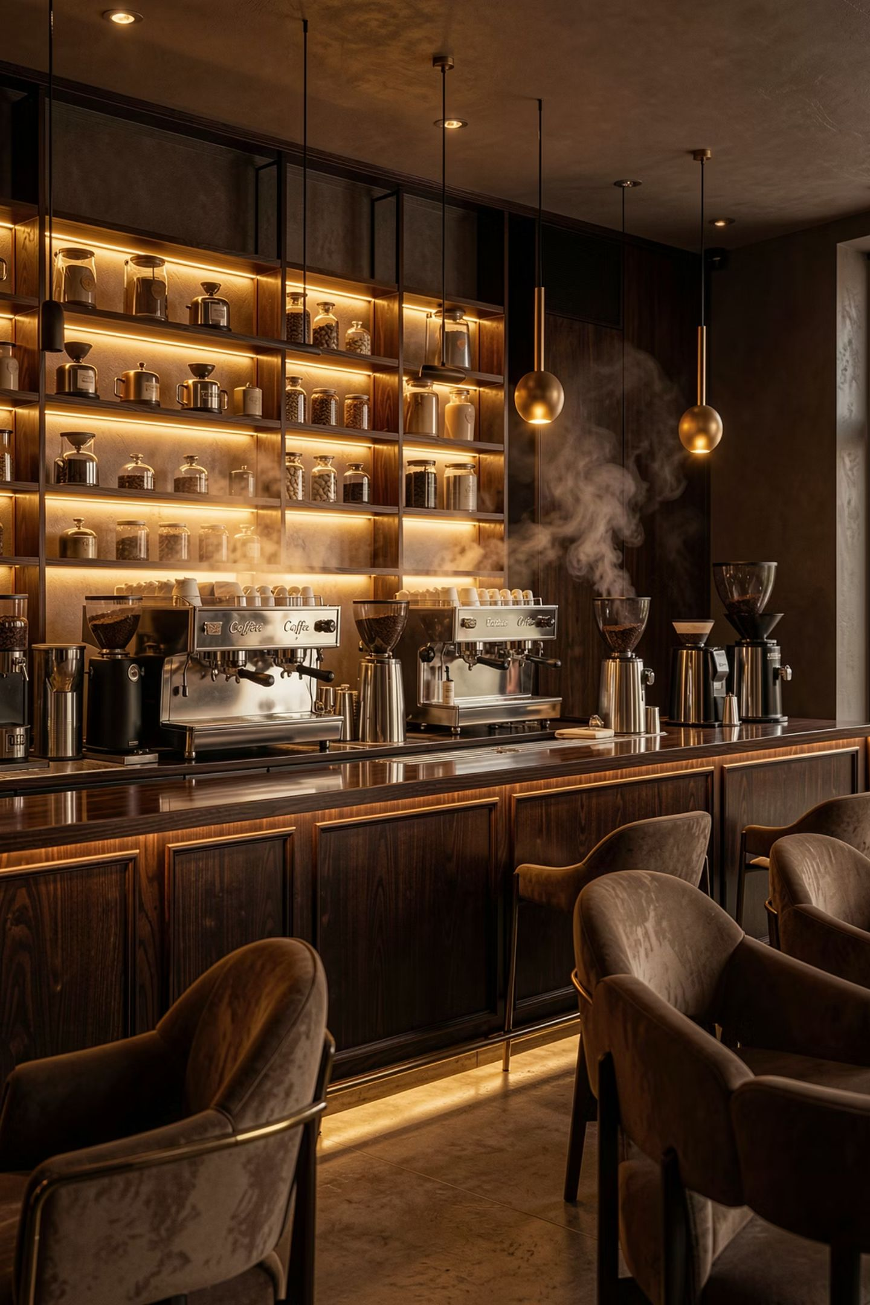
Bright Coffee: CEO Business Performance Review
Data-driven growth, customer behaviour and commercial opportunities — H1 2024 Analysis
EXECUTIVE BRIEFING
H1 2024

Slide 2

Executive Summary
Bright Coffee has delivered exceptional first-half performance — revenue nearly doubled from January to June, driven by broad-based category growth and consistent demand across all three locations.
$698K
149K
Total Revenue
Transactions
H1 2024
H1 2024
214K
$4.69
Units Sold
Avg. Transaction
H1 2024
Per visit
🚀 103.8% Revenue Growth
☕ Coffee + Tea = Core Engine
📍 Hell's Kitchen Leads
Revenue more than doubled from January to June — a remarkable growth trajectory across all categories and stores.
Coffee and Tea together account for over 69% of total revenue, anchoring the business and driving consistent volume.
At $236,511, Hell's Kitchen is the highest-performing location — a proven operational blueprint for the wider estate.
CEO Takeaway: Bright Coffee is growing strongly — the opportunity now is to scale what is working and optimise operations to sustain momentum profitably.

Slide 3


Revenue Performance: A Strong Foundation
$698,812
Total H1 Revenue
149,116
Total Transactions
214,470
Units Sold
$4.69
Average Transaction Value
The business generated strong transaction volumes at a consistent average transaction value of $4.69, indicating reliable, repeatable purchasing behaviour rather than one-off spikes. Every metric is moving in the right direction.
CEO Takeaway: High transaction frequency at a healthy average value confirms customer loyalty — the next lever is increasing the average basket size through cross-sell.

Slide 4
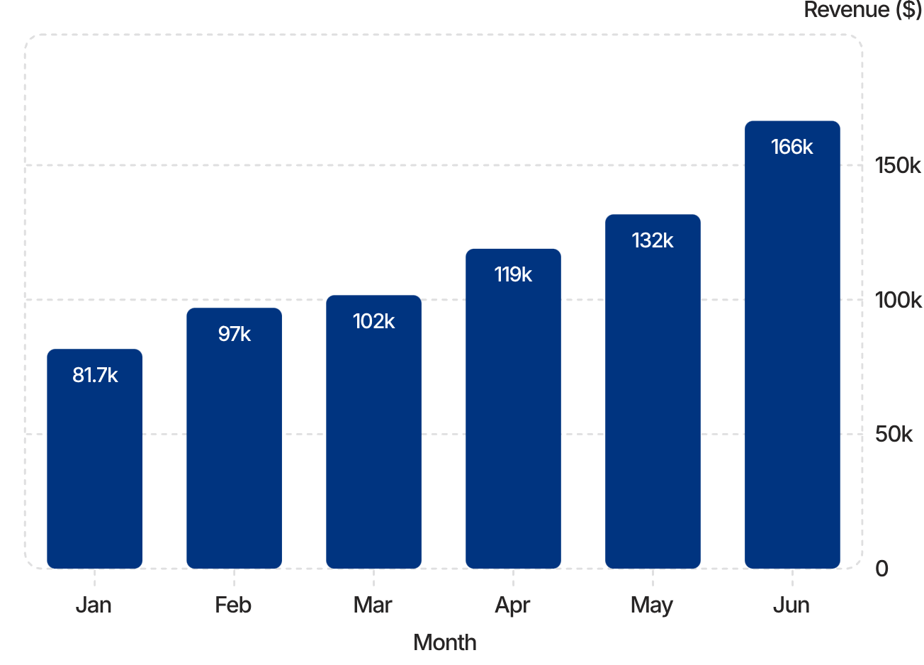

Revenue Growth: January to June
103.8% Growth in Six Months
Revenue climbed from $81,677 in January to $166,486 in June — more than doubling in a single half-year period.
Growth was not a one-month spike. The trajectory is consistent month-on-month, reflecting genuine operational momentum and increasing customer demand rather than a seasonal anomaly.
Jan → Jun
+103.8%
+$84,809 absolute gain
Period growth rate
CEO Takeaway: The consistent month-on-month growth curve signals compounding demand — this is a business building real momentum, not chasing one-off peaks.

Slide 5
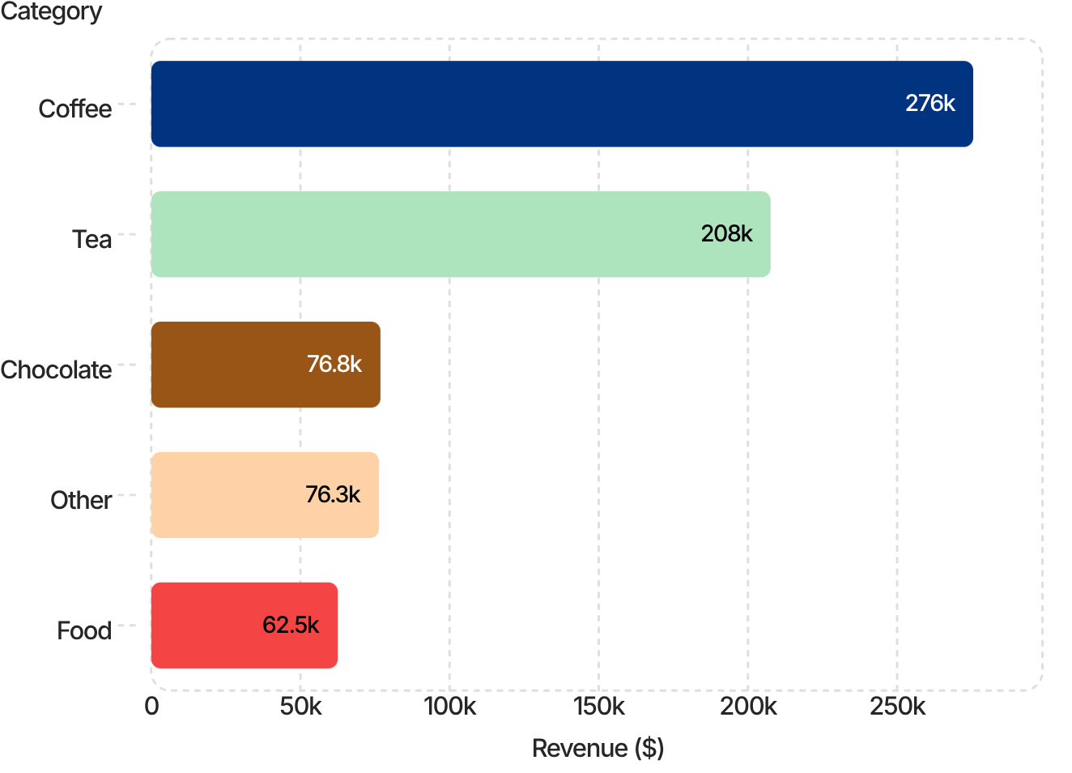
Category Performance: Where Revenue is Won
Coffee + Tea: The Revenue Engine
Coffee alone contributes $275,513 — 39% of total revenue. Combined with Tea ($207,620), these two categories account for over 69% of all revenue.
Chocolate, Other, and Food form a meaningful secondary tier, collectively contributing $215,680 — significant upside if cross-sell rates improve.
Category
Revenue
Units
Coffee
$275,513
89,569
Tea
$207,620
70,947
Chocolate
$76,824
17,944
Other
$76,334
18,584
Food
$62,522
17,426
CEO Takeaway: Coffee and Tea anchor the business — but Food and Chocolate represent high-margin attach opportunities with every core beverage transaction.

Slide 6
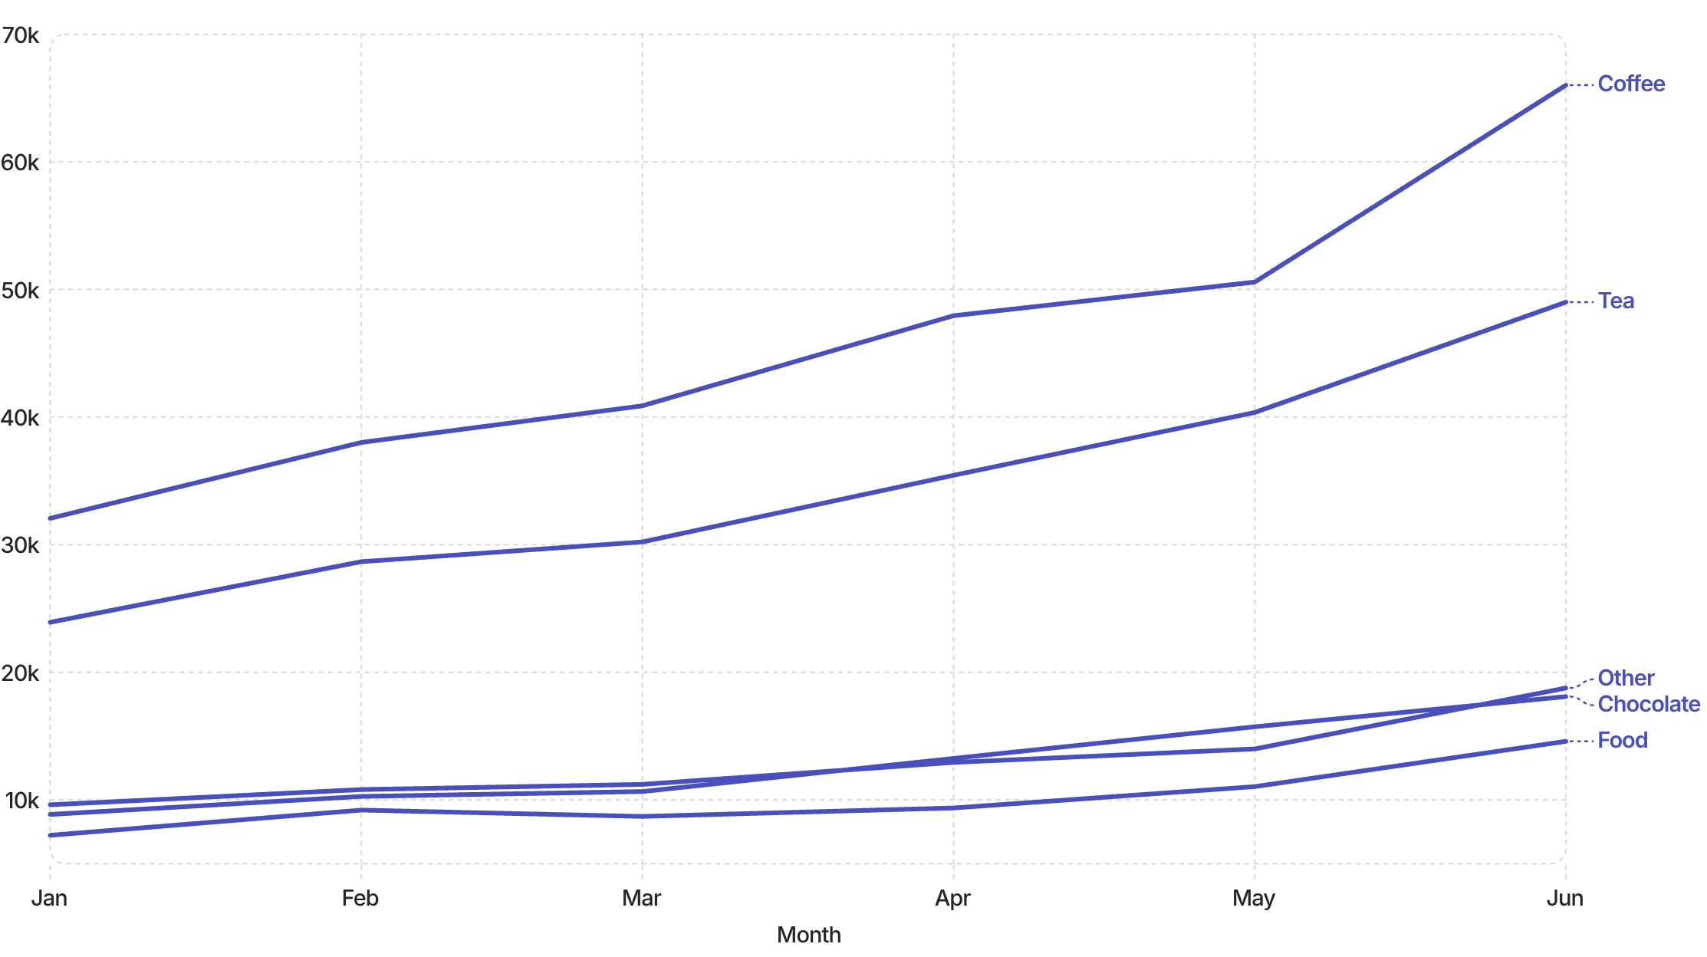

Category Growth: Broad-Based Momentum
Every category grew significantly from January to June. Coffee surged from $32,063 to $66,019 (+106%); Tea from $23,916 to $49,014 (+105%); Food from $7,225 to $14,588 (+102%). Growth is not concentrated — it is broad-based and structural.
CEO Takeaway: Broad-based category growth confirms the business model is sound — all product lines are scaling, which reduces concentration risk and supports sustainable expansion.

Slide 7
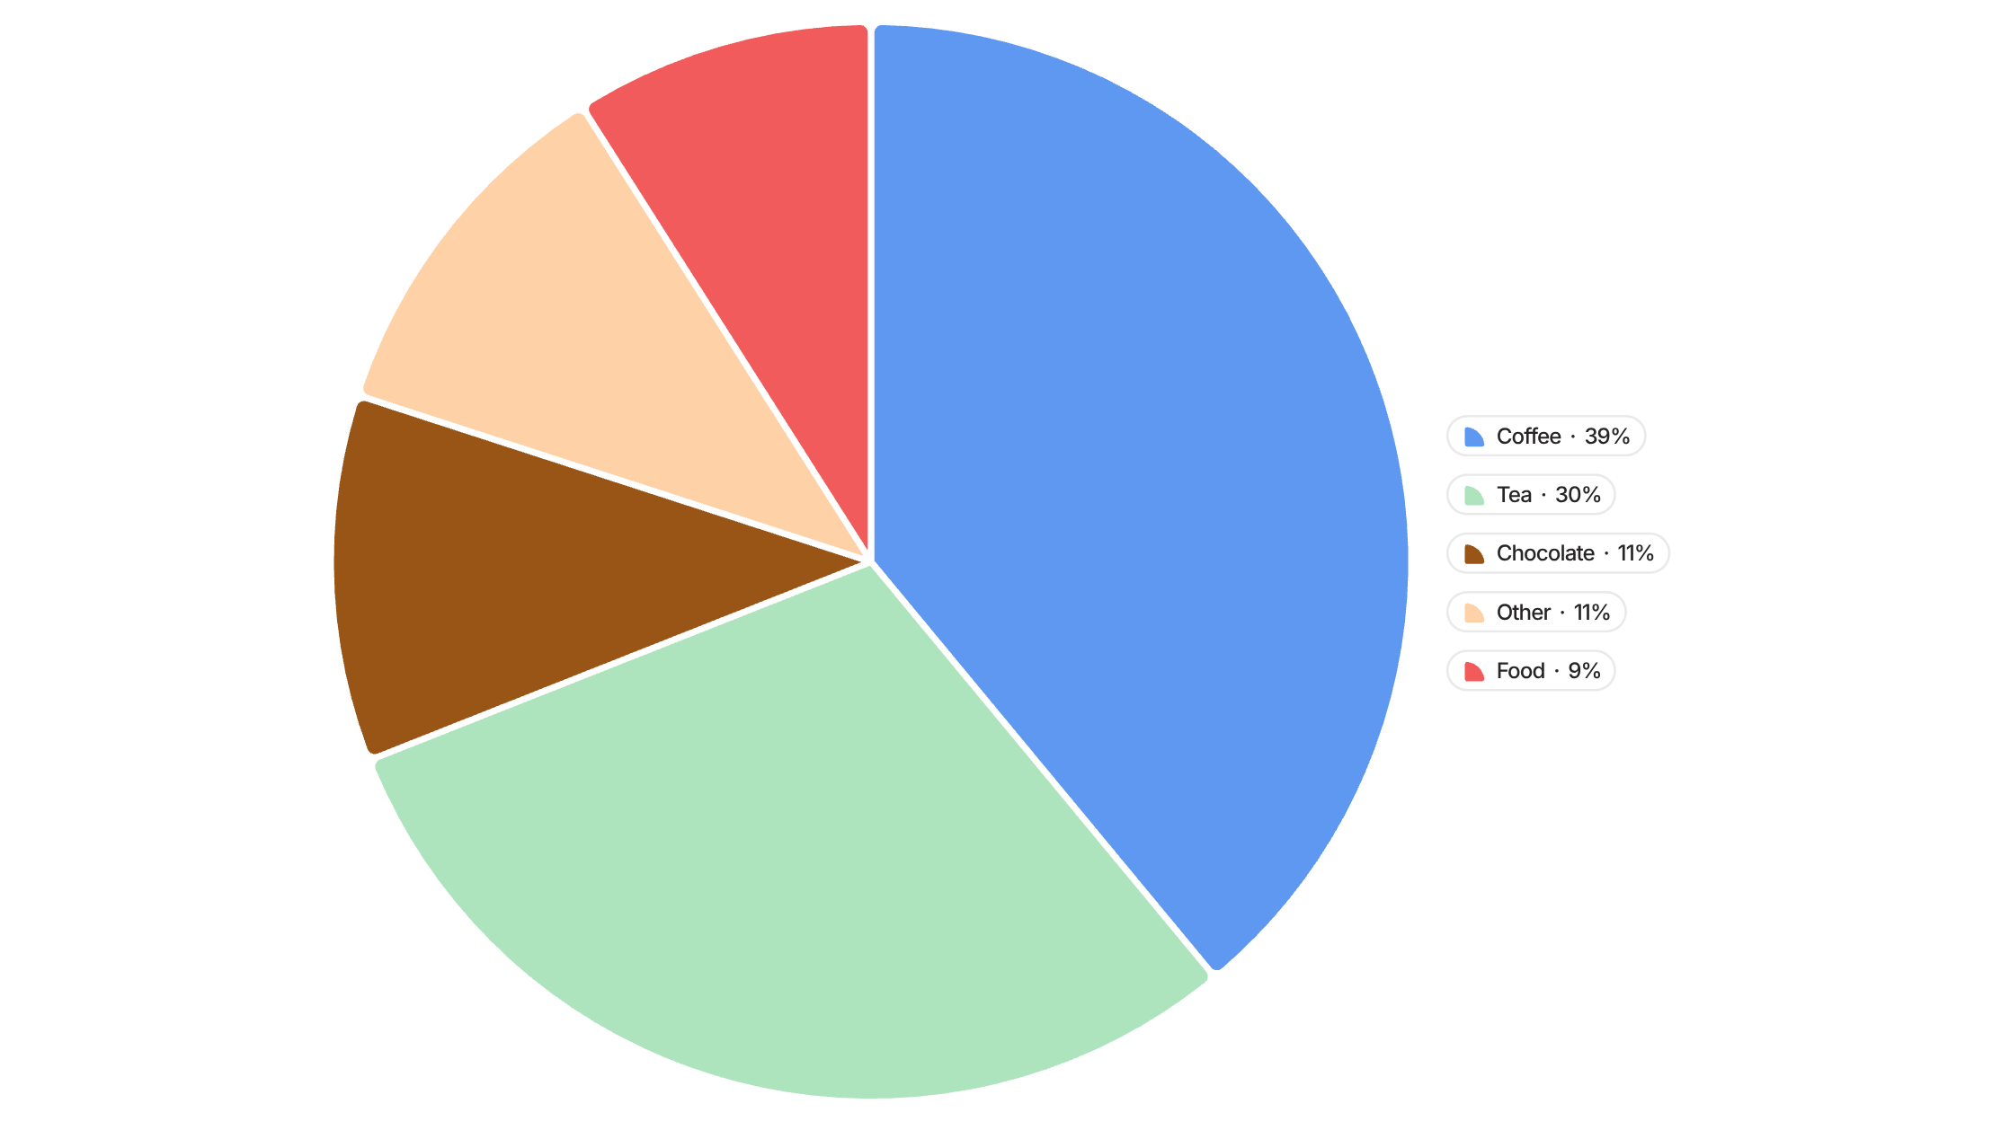
Revenue Mix: Category Distribution
This pie chart clearly illustrates the dominance of our core beverage offerings. Coffee (39%) and Tea (30%) collectively represent 69% of Bright Coffee's total H1 revenue, cementing their position as the primary drivers of our sales.
CEO Takeaway: The strong performance of Coffee and Tea validates our core offering — focus should now be on strategic upsells and increasing attachment rates for higher-margin categories like Food and Chocolate to diversify and grow.

Slide 8
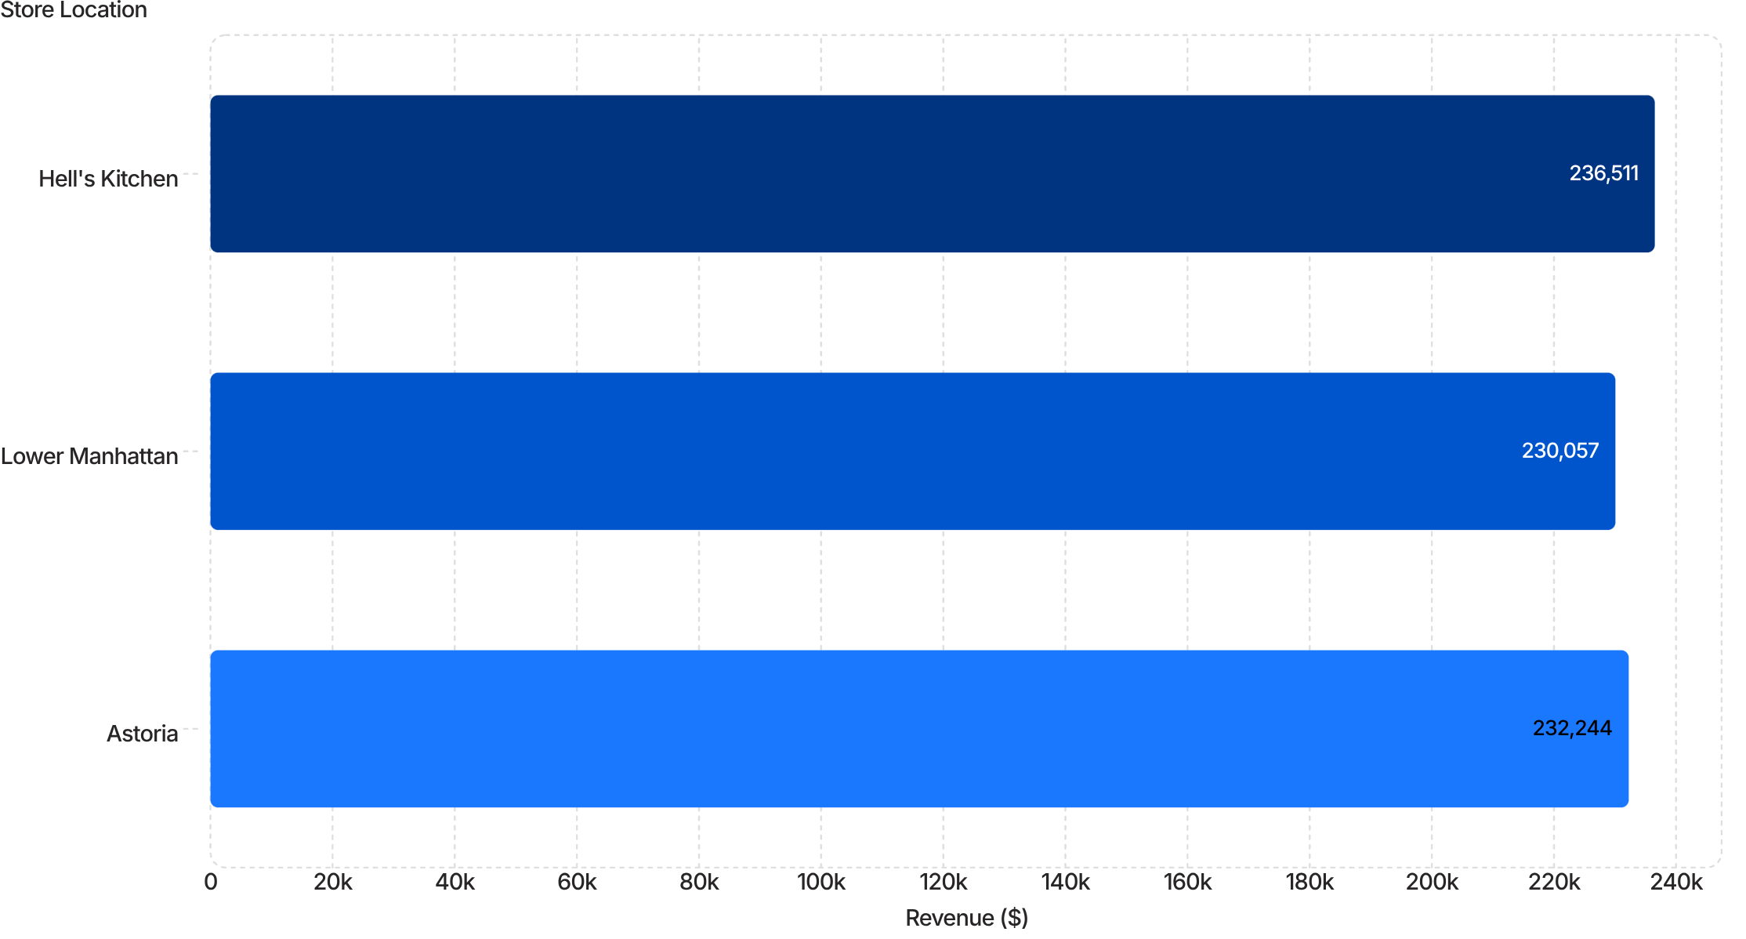
Store Revenue Comparison: Three-Location Analysis
The revenue distribution across our three prime locations demonstrates remarkable parity. With Hell's Kitchen leading slightly at $236,511, followed closely by Astoria and Lower Manhattan, this indicates a consistent customer demand and operational efficiency across the estate.
This even performance suggests that our growth strategies and product offerings resonate uniformly, providing a robust foundation for future expansion without significant geographical discrepancies.
CEO Takeaway: The nearly identical revenue performance across all three stores is a powerful validation of our business model's replicability and scalability — we have a proven blueprint for success.

Slide 9
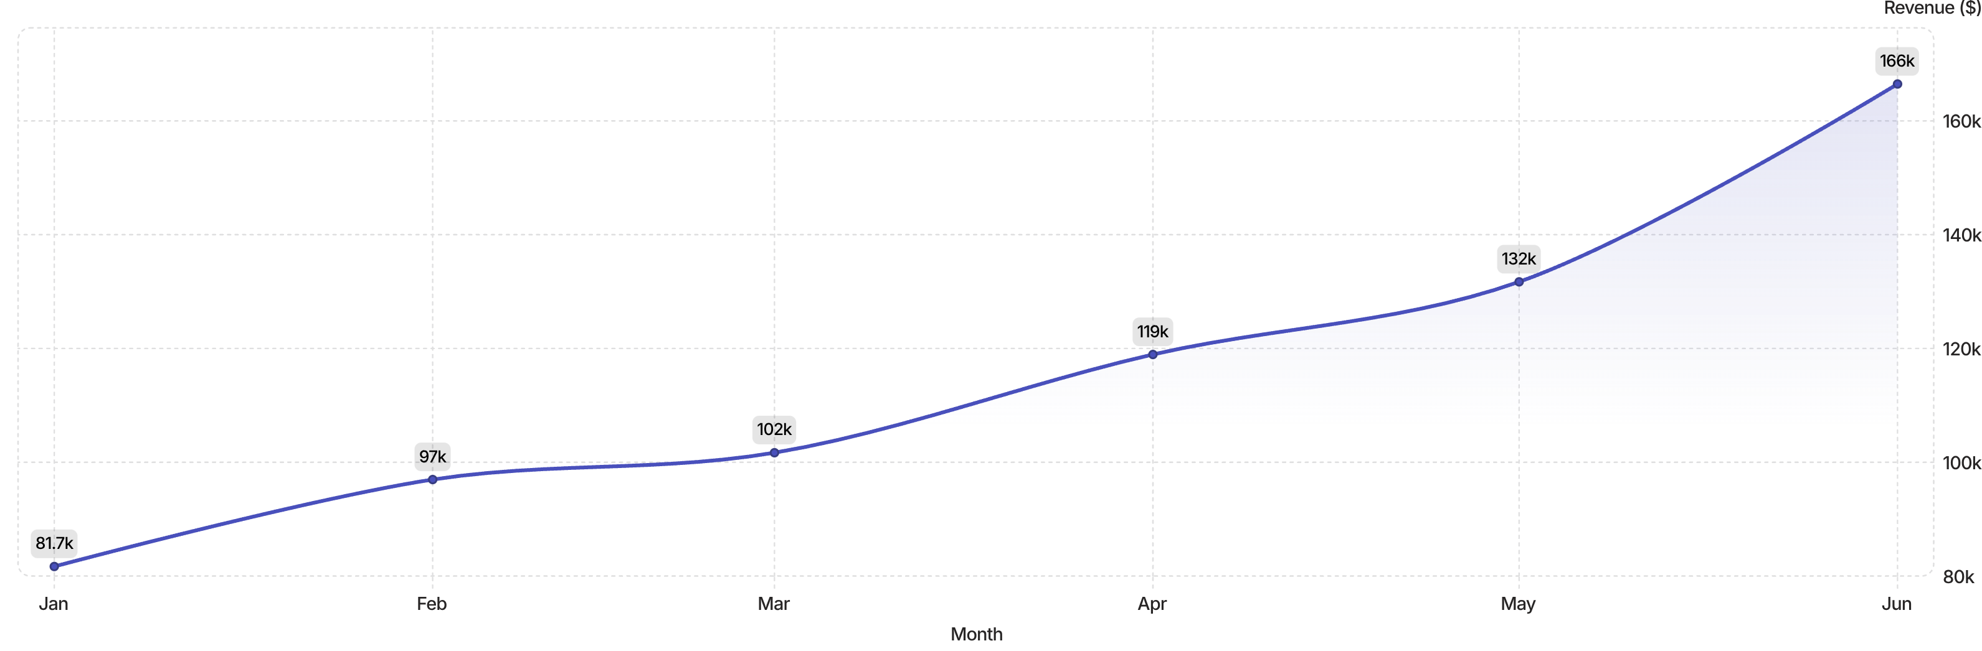
Monthly Growth Trajectory: Revenue Acceleration
Bright Coffee's revenue exhibited a remarkable and consistent upward trend throughout the first half of 2024, demonstrating robust market penetration and increasing customer loyalty.
Revenue surged from $81,677 in January to an impressive $166,486 in June, signifying a 103.8% growth over the six-month period. This consistent acceleration month-over-month underscores a powerful, sustained momentum across the business, rather than isolated spikes.
Consistent Upward Trend
Clear Acceleration
Each month demonstrated an increase, reinforcing the strength and stability of the underlying business model.
The steepening curve towards June highlights growing operational efficiency and expanding market demand.
CEO Takeaway: The sustained revenue acceleration is a strong indicator of market fit and effective execution. Our focus must now be on leveraging this momentum to capture even greater market share and scale operations.

Slide 10
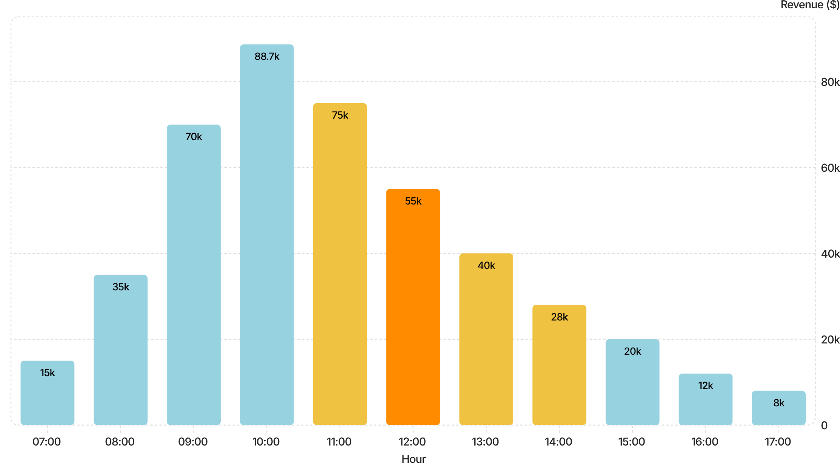
Peak Hours Analysis: Where Revenue Concentrates
Understanding hourly revenue distribution is key to optimizing staffing, inventory, and marketing efforts. The data reveals clear peaks and troughs throughout the day.
The chart clearly shows a dominant morning window, with revenue peaking at $88,673 at 10:00 AM. The period from 09:00 to 11:00 AM accounts for the vast majority of daily sales, indicating robust customer traffic during these hours.
CEO Takeaway: The pronounced morning peak highlights a critical opportunity for tailored promotions and optimized staffing. Maximizing efficiency during these hours is paramount for overall revenue growth.

Slide 11
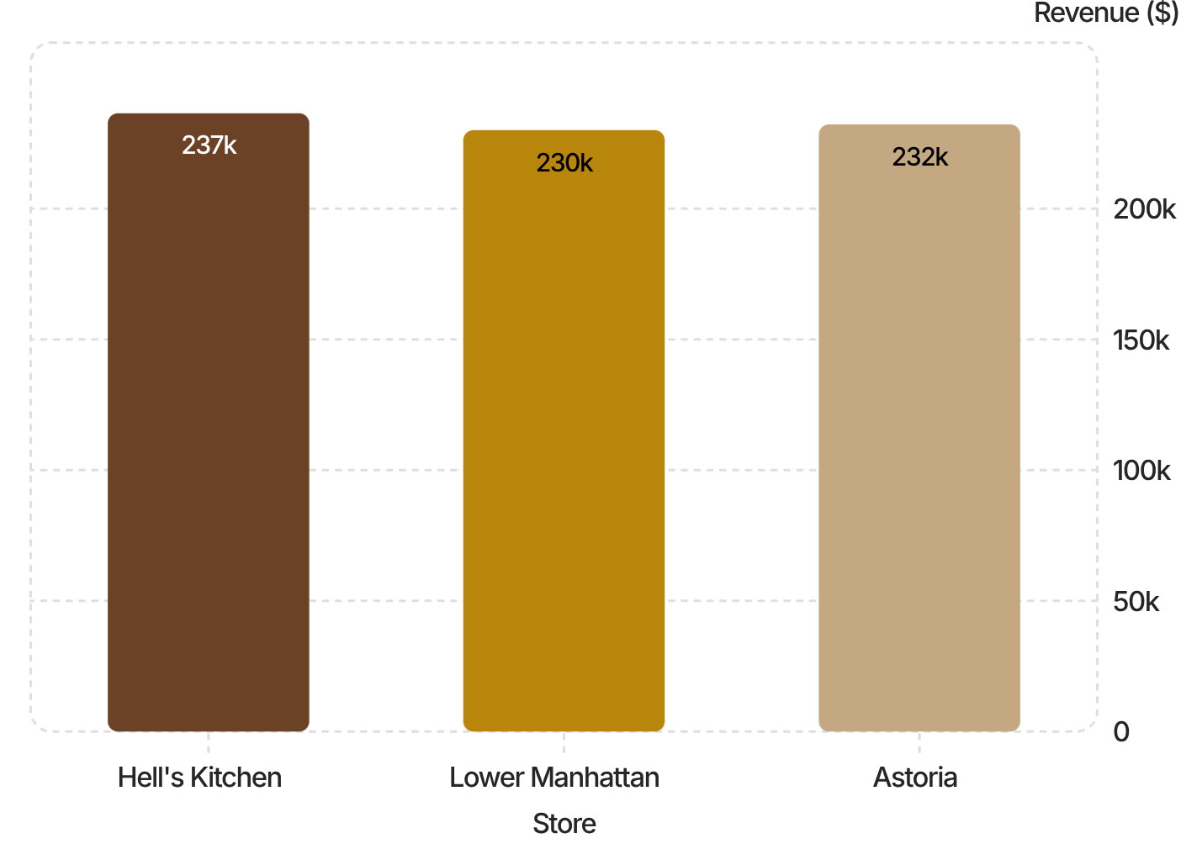

Store Performance: Hell's Kitchen Leads the Way
Hell's Kitchen: The Benchmark Location
At $236,511, Hell's Kitchen edges ahead as the top-performing store. Notably, all three locations are within 3% of each other in total revenue — a sign of consistent operational delivery across the estate.
Hell's Kitchen demonstrates particularly strong morning trading (8:00–10:00), suggesting effective staffing and product availability during peak demand. Lower Manhattan mirrors this morning concentration. Astoria shows a broader afternoon and evening trading pattern, pointing to a distinct customer base and opportunity for tailored scheduling.
Operational Lesson: Hell's Kitchen's morning execution playbook can be replicated systematically across Lower Manhattan and Astoria.
CEO Takeaway: Remarkable revenue parity across stores confirms scalable operations — codify Hell's Kitchen's morning model as the estate-wide standard.

Slide 12
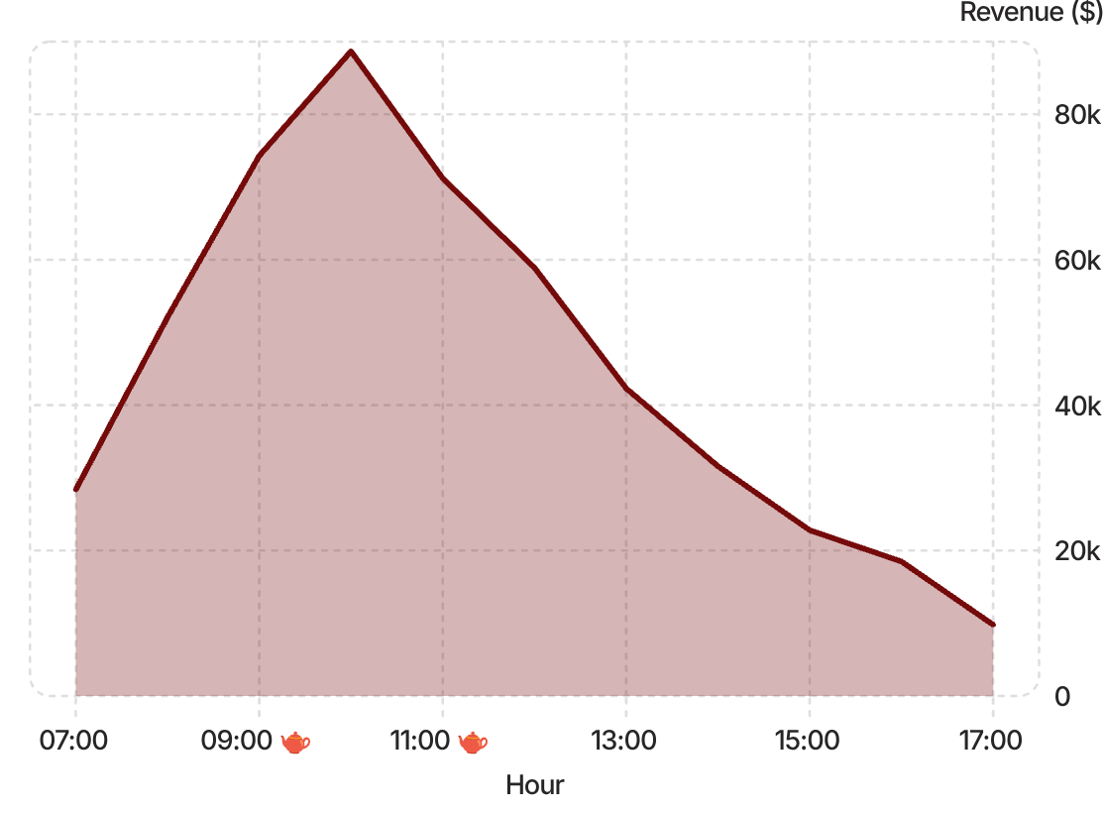

When Customers Buy: Time-of-Day Intelligence
9:00 AM
Strong revenue; coffee & tea dominant
10:00 AM
Peak hour — $88,673
10:30 AM
Peak 30-minute slot — $44,967
2PM-4PM
Capacity underutilised; weak sales
The vast majority of daily revenue is generated between 8:00 and 11:00. This is not a soft trend — it is a structural concentration that has direct implications for how the business should be run.
Staffing
Inventory
Front-load rotas to the 8–11 window
Ensure peak-hour stock is fully available before 8:00
Service
Protect throughput capacity at the critical 10:00–10:30 peak
CEO Takeaway: Win the morning and you win the day — operational excellence in the 8:00–11:00 window is the single highest-leverage improvement available.

Slide 13



Commercial Opportunities & 30/60/90-Day Plan
30 Days
60 Days
90 Days
Protect Peak Hours
Audit staffing rotas and inventory processes for the 8:00–11:00 window at all three stores. Zero tolerance for stock-outs during peak demand.
Cross-Sell & Attach Rate
Launch structured prompts to pair Food and Chocolate with every Coffee and Tea transaction. Target uplift in average transaction value from $4.69.
Store Playbook Rollout
Document Hell's Kitchen's morning model and deploy systematically to Lower Manhattan and Astoria. Review Astoria's afternoon pattern for targeted scheduling.
Data-Backed Findings
Recommendations
10:00 is the single highest-revenue hour at $88,673
Coffee + Tea represent 69%+ of all revenue
All categories grew 100%+ in H1
Hell's Kitchen leads on morning throughput
Anchor marketing and promotions on Coffee and Tea
Use Food and Chocolate as structured attach products
Monitor weaker afternoon trading for efficiency savings
Standardise peak-hour operational protocols estate-wide
CEO Takeaway: The data is clear — optimise the morning, grow the basket, and replicate the best-performing store model. Three actions, measurable outcomes.

Slide 14
CEO Decisions Required
Three clear approvals will unlock the next phase of Bright Coffee's growth:
1
2
3
Approve Peak-Hour Operational Optimisation
Approve Category Cross-Sell Initiative
Approve Store-Level Playbook Rollout
Mandate estate-wide staffing and inventory protocols focused on the 8:00–11:00 revenue window. Assign ownership and set a 30-day review milestone.
Greenlight a structured attach-rate programme pairing Food and Chocolate with core Coffee and Tea transactions — targeting measurable uplift in average transaction value.
Commission a best-practice playbook based on Hell's Kitchen's proven patterns and deploy systematically across Lower Manhattan and Astoria within 90 days.
Bright Coffee has the growth trajectory, the customer demand, and the operational foundation to scale significantly. The priority is now to sustain this growth profitably — though it should be noted that margin and profitability data were not available in the dataset and must be incorporated into the next phase of analysis before confirming unit economics.
CEO Takeaway: The business is performing. These three decisions convert momentum into durable, scalable success.

